Slide 1

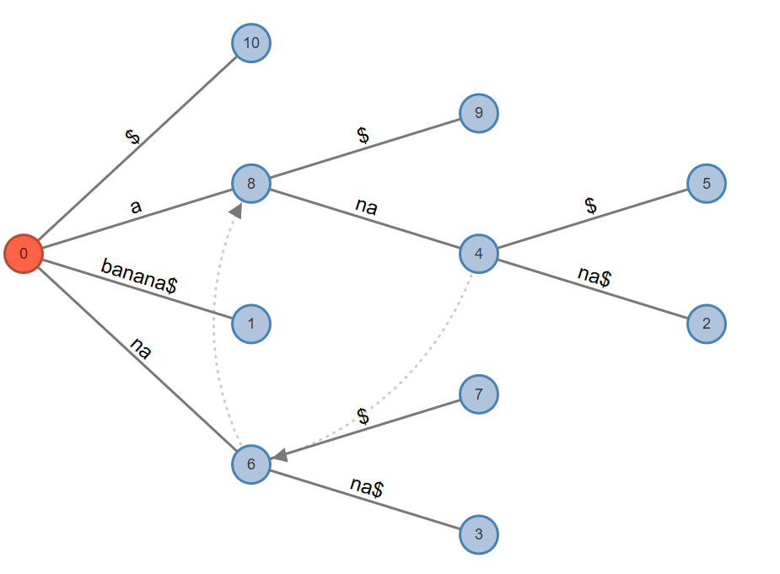
SUFFIX TREE
INTRODUCTION:
A suffix tree (also called PAT tree or position tree)
A suffix tree is a compressed tree containing all the suffixes of the given text as their keys and positions in the text as their values.
Suffix trees allow particularly fast implementations of many important string operations.
PROPERTIES:
The suffix tree for a text X(any text) of size n from an alphabet of size “d”.
Stores all the n(n-1)/2 suffixes of X in O(n). space and can be constructed in O(dn) time.
Supports arbitrary pattern matching and prefix matching queries in O(dm) time, where m is the length of the pattern.
APPLICATION
Pattern searching .
Finding the longest repeated substring.
Finding the longest palindrome(reverse) in a string.
Lowest common ancestors.
Finding the longest common substring.
PATTERN SEARCH IN SUFFIX TREE:
a)For the current character of pattern, if there is an edge from the current node of suffix tree, follow the edge.
b)If there is no edge, then pattern does not exist and return.
If all characters of pattern have been processed, i.e., there is a path from root for characters of the given pattern, then pattern is found.
GROUP MEMBERS:
ZOHA WASEEM 18B-004-SE
NOMAN AKHTAR 18B-007-SE
ZEESHAN ASLAM 18B-044-SE

